Slide 1
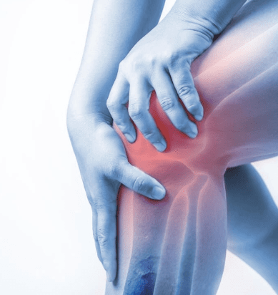
Knee Osteoarthritis Classification Using Computer Vision machine learning
Team Members:
Milind Kumar Choudhary
Rahul Singh
Saatvik Chaudhari
Andrew Dinspechin

Slide 2
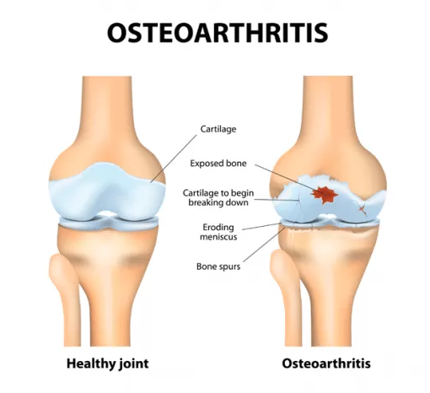
Introduction
Osteoarthritis (OA) is a common degenerative joint disease, particularly affecting older adults, leading to pain, disability, and reduced quality of life. Traditionally, knee OA severity is assessed using the manual Kellgren-Lawrence (KL) grading scale, which can be inconsistent and time-consuming. Automated bone distance measurements offer an efficient alternative by indirectly estimating cartilage thickness and streamlining diagnosis. By extracting femur-tibia bone distances from MRI-derived bone masks, this method reduces reliance on manual cartilage analysis and enables integration into machine learning workflows for more consistent and automated OA severity classification.

Slide 3
Project Objectives
Develop a computer-aided diagnosis system for knee osteoarthritis (OA) severity classification using bone distance measurements as an indirect measure of cartilage thickness.
Bone Distance Measurement: Create an algorithm to measure femur-tibia bone distances from MRI-derived bone masks, accurately capturing relevant bone gaps.
Feature Extraction: Automate the selection of valid MRI slices containing both femur and tibia bones, ensuring robust and consistent feature extraction across cases.
Machine Learning Classification: Use extracted distance vectors as features to train machine learning models (e.g., CNN, SVM) to predict OA severity based on Kellgren-Lawrence (KL) grading.
Performance Optimization & Evaluation: Refine algorithms, explore better feature representations, and evaluate model performance using classification accuracy and ROC analysis for improved OA severity predictions.

Slide 4
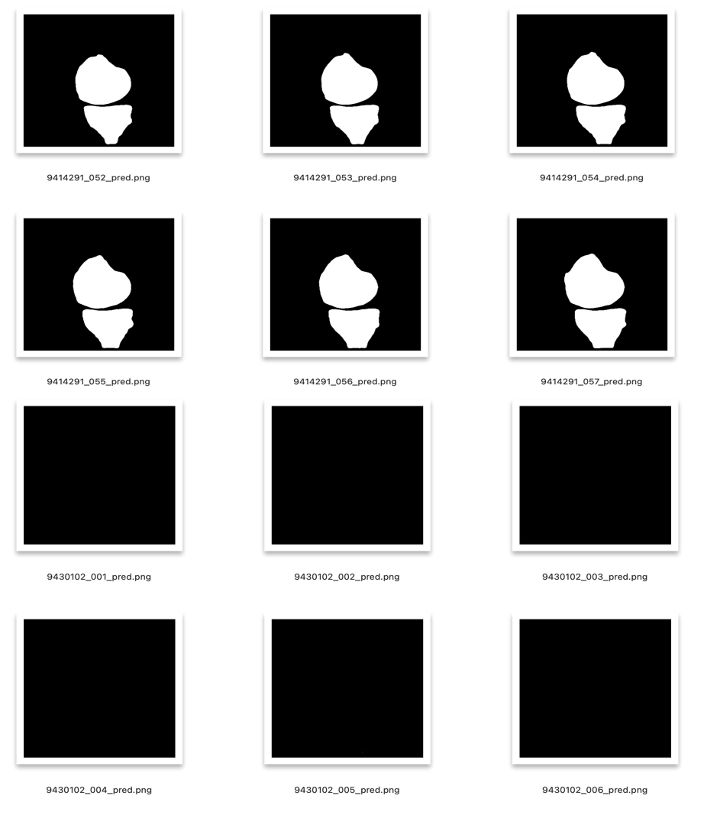
Datasets
Dataset Overview: 197 patients, each with 160 MRI slices.
Classification Labels: Based on the Kellgren-Lawrence (KL) scale: Classes (“V00XRKL” & “V03KL”)
Non-OA: KL 0–2
OA: KL 3–4

Slide 5
Steps Followed
STEP 1: Segmentation & Preprocessing
Bone masks were binarized using Otsu's method for adaptive thresholding, followed by morphological closing to smooth contours and eliminate small artifacts.
STEP 2: Feature Extraction
Femur and tibia contours were detected and sorted by area to exclude irrelevant structures. Euclidean distances between the contours were averaged for each slice, generating a feature vector, which was saved to a new .csv file.
STEP 3: Feature Engineering & EDA
The feature vector csv was merged with the KL grades dataset. Exploratory Data Analysis (EDA) was performed to identify patterns, clean the data, and ensure it was ready for modeling.
STEP 4: Classification
The extracted features were used to train a Random Forest Classifier & CNN for OA severity prediction, with performance validated through 10-fold cross-validation.
STEP 5: Optimization
Refine the distance measurement algorithm and experiment with slice selection strategies, such as skipping neighboring slices or excluding middle transition slices, to improve feature representation and model accuracy.

Slide 6
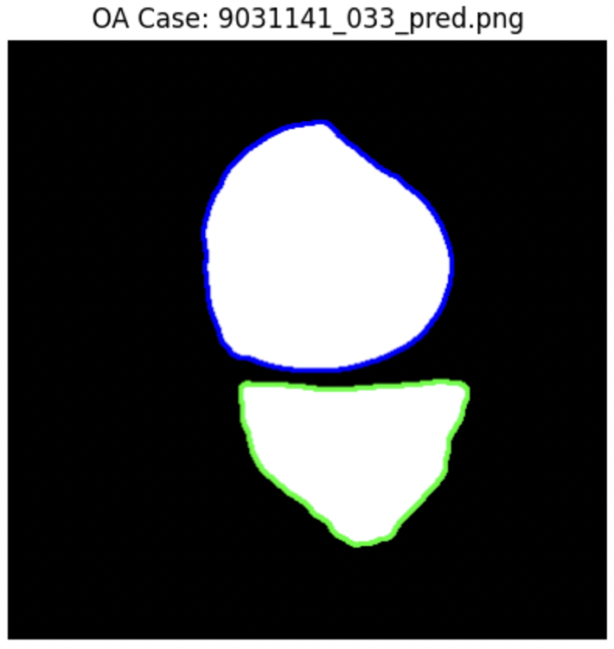
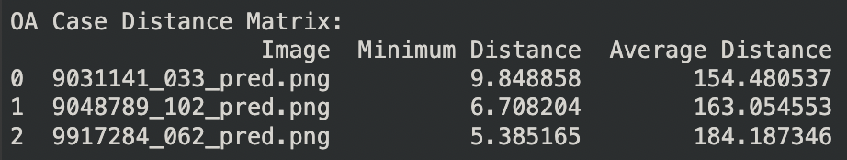
STEP 1: Segmentation & Preprocessing
Distance Calculation: Computes minimum and average distances between femur and tibia contours.
Slice Validation: Identifies slices with both femur and tibia bones.
Valid Slice Detection: Finds the range of valid slices.
Slice Sampling: Selects slices at regular intervals (e.g., every 2nd slice).
Output: Reports valid range, sampled slices, and counts.

Slide 7
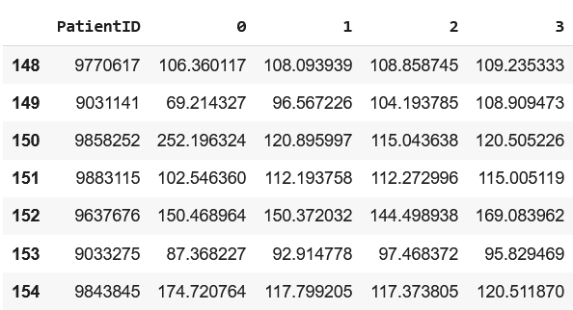
STEP 2: Feature Extraction
Distance Measurement:
Calculates the average Euclidean distance between femur and tibia contours for each sampled slice.
Feature Vector Generation:
Aggregates distances for each patient, pads vectors to uniform length, and saves them as a CSV file.

Slide 8
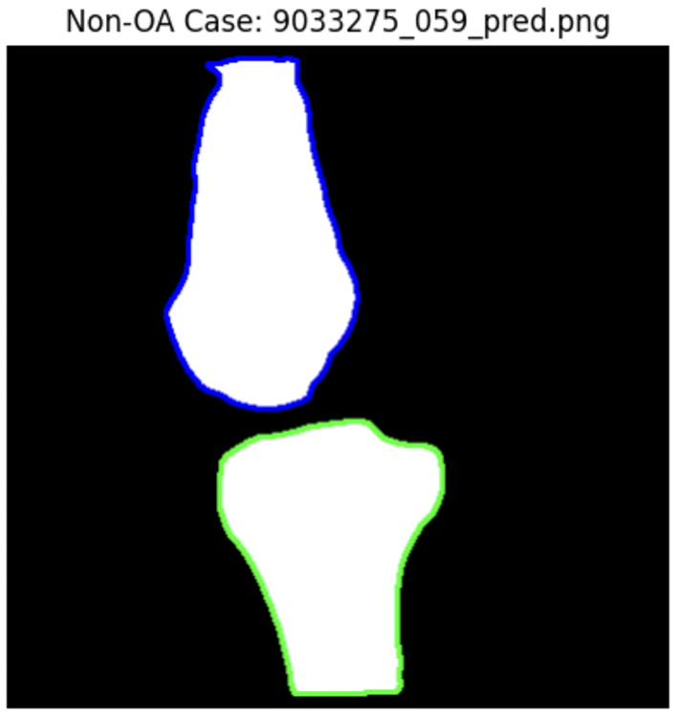
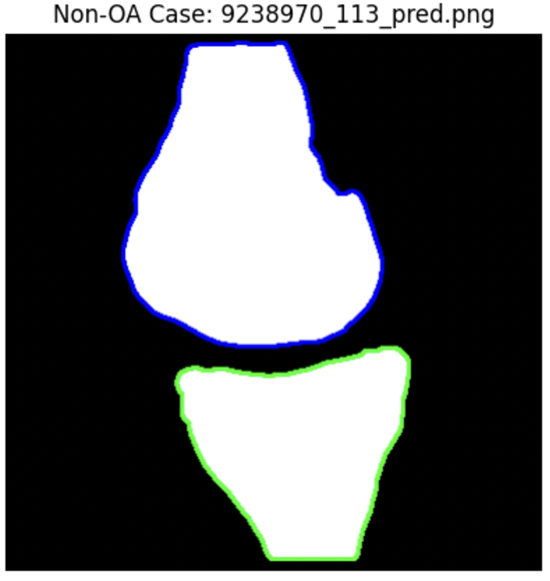
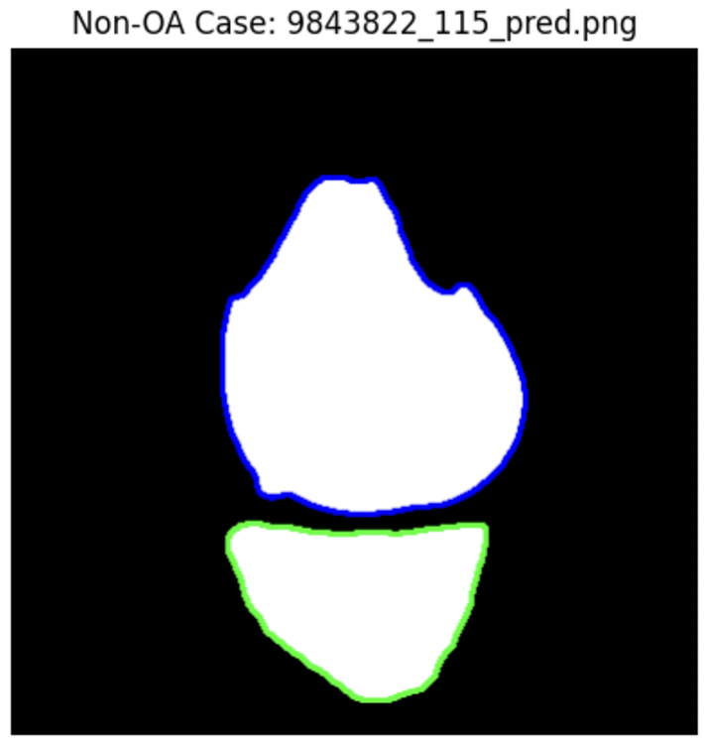
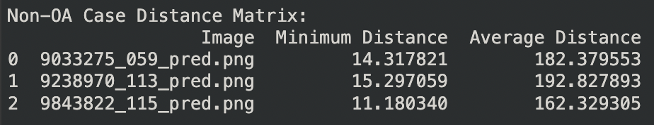
Testing of Non-OA cases

Slide 9
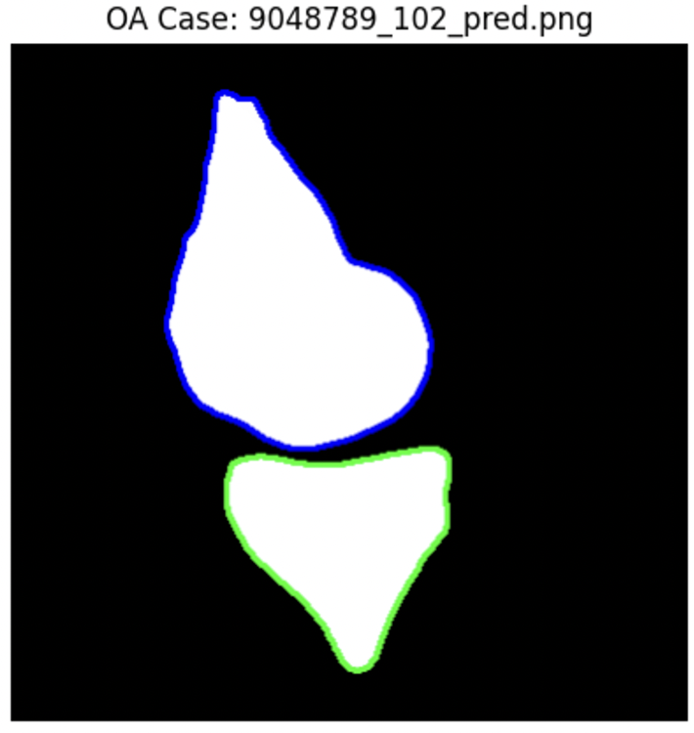
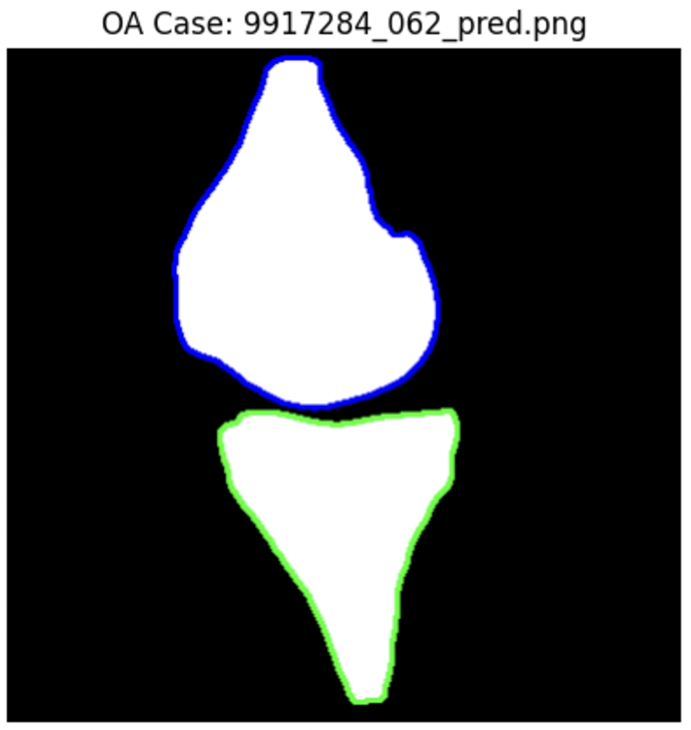
Testing of OA cases

Slide 10
STEP 3: Feature Engineering & EDA
Data Loading: Reads two datasets – KL grade data (df_baseline) and feature vectors (df_features) – into pandas DataFrames.
Column Renaming: Standardizes the column names (cases → Patient_ID and PatientID → Patient_ID) for merging.
Data Merging: Combines the two DataFrames on the Patient_ID column to align KL grades with corresponding feature vectors.
Data Cleaning: Drops the unnecessary column 'Unnamed: 3' and prints the shape of the final merged DataFrame.

Slide 11
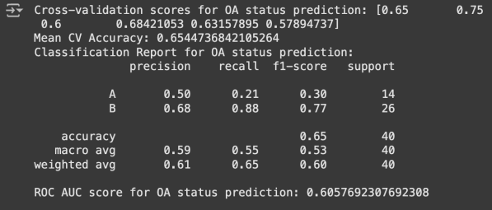
STEP 4: Classification Using ML Algorithms
Data Split: Prepares features and target, encodes labels, and splits data (80-20).
Model Training: Trains a Random Forest Classifier.
Validation: Runs 10-fold cross-validation for performance.
Evaluation: Computes mean cross-validation score and ROC AUC.

Slide 12
STEP 5: Optimization
Feature Vectors Creation: Generated 3 feature vectors with Step = 1, 2, 3 having sizes (197, 117), (197, 74), and (197, 52), respectively.
Feature Selection: Identified important features (e.g., Step = 1 reduced to size (197, 34)) and filled zeros with row-wise averages.
Model Training: Trained Random Forest models with and without "V00XRKL" for the target "V03KL" and tested CNN models for comparison using hyperparameters & best hyperparameters.
Approaches & Evaluation: Tested a total of 27 approaches using all feature vectors and evaluated model accuracies to find optimal results.

Slide 13
Observations & Results
 | STEP = 1 | STEP = 2 | STEP = 3
Excluding “V00XRKL” | 66.55% | 67.30% | 61.40%
Including “V00XRKL” | 76.64% | 75.96% | 72.52%
Excluding “V00XRKL” (CNN) | 52.50% | 52.50% | 60%
Including “V00XRKL” (CNN) | 67.25% | 60.23% | 60%
We can observe that Step=1, which is processed with feature importance & trained over Random Forest is giving the best results.

Slide 14
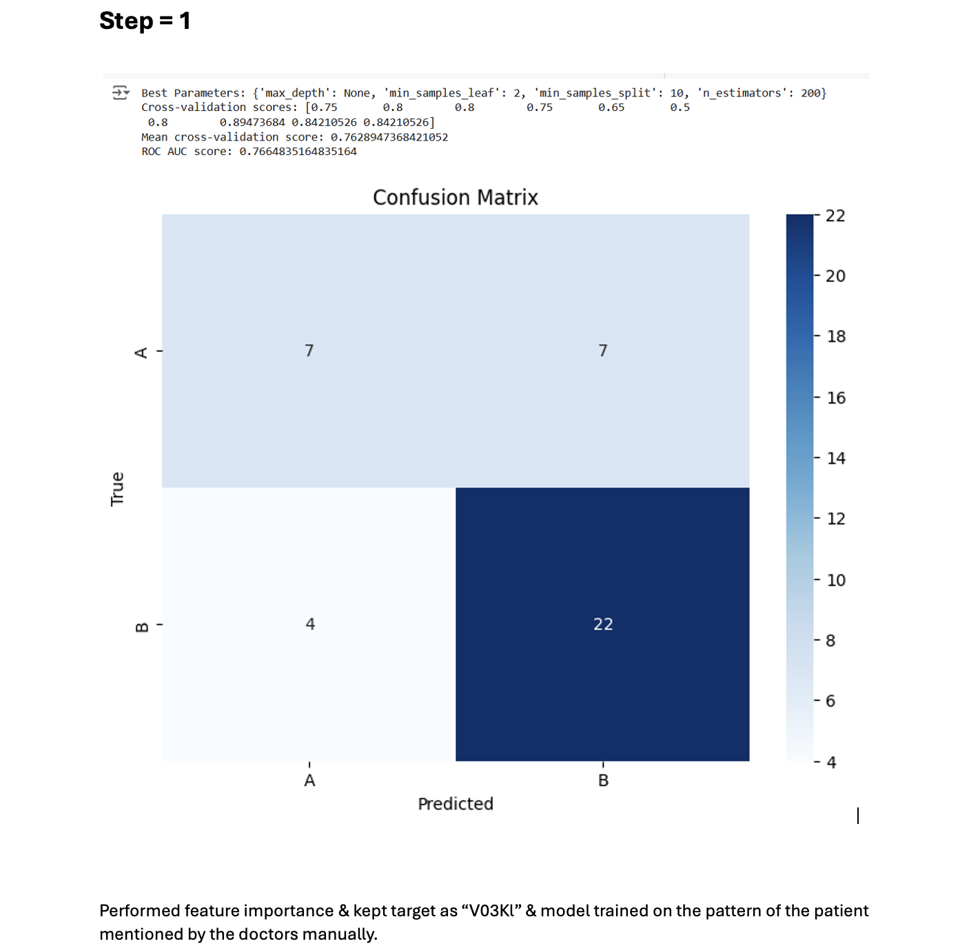
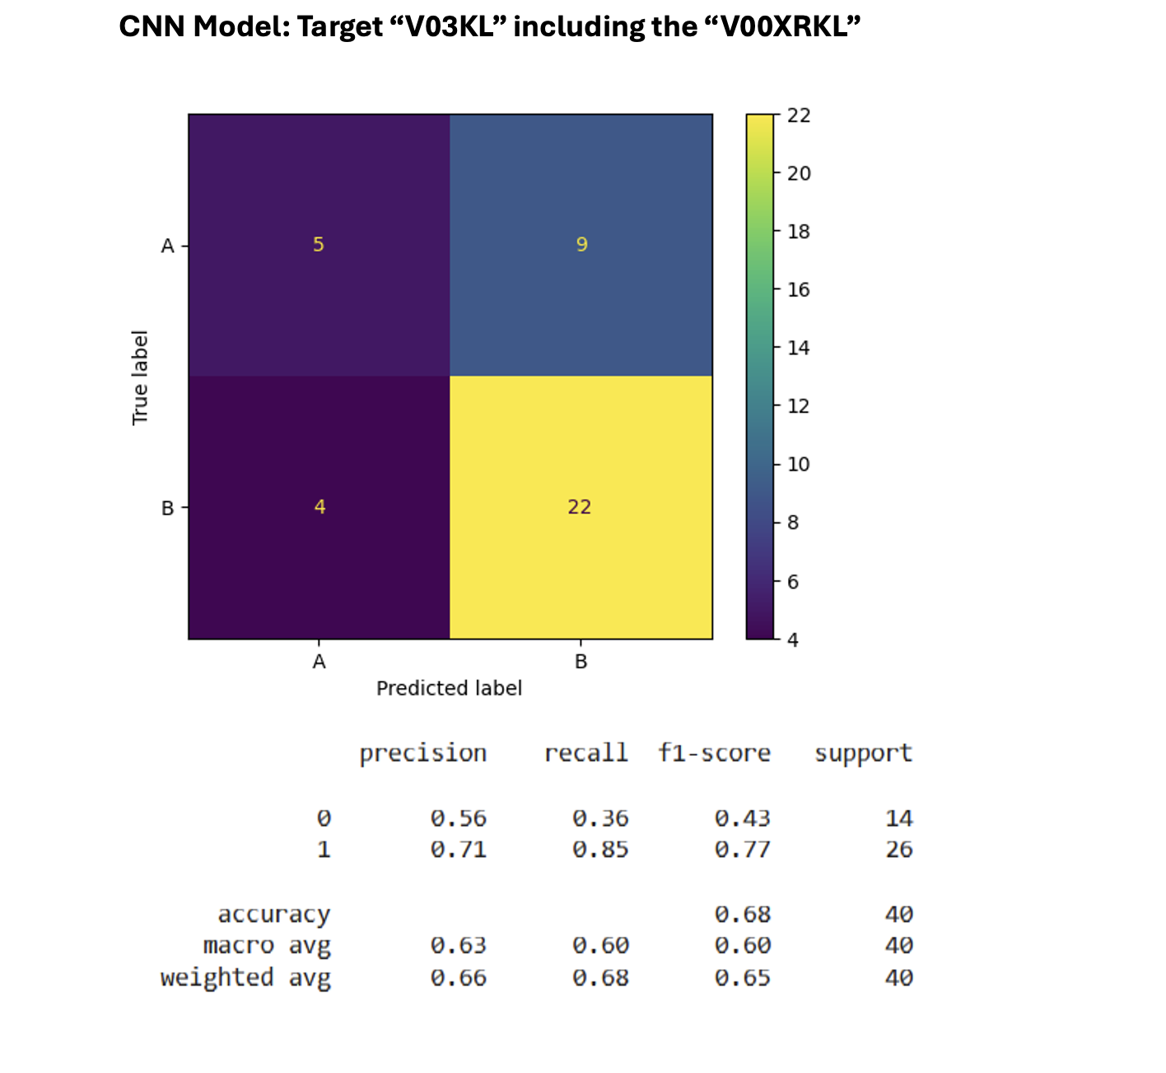

Slide 15
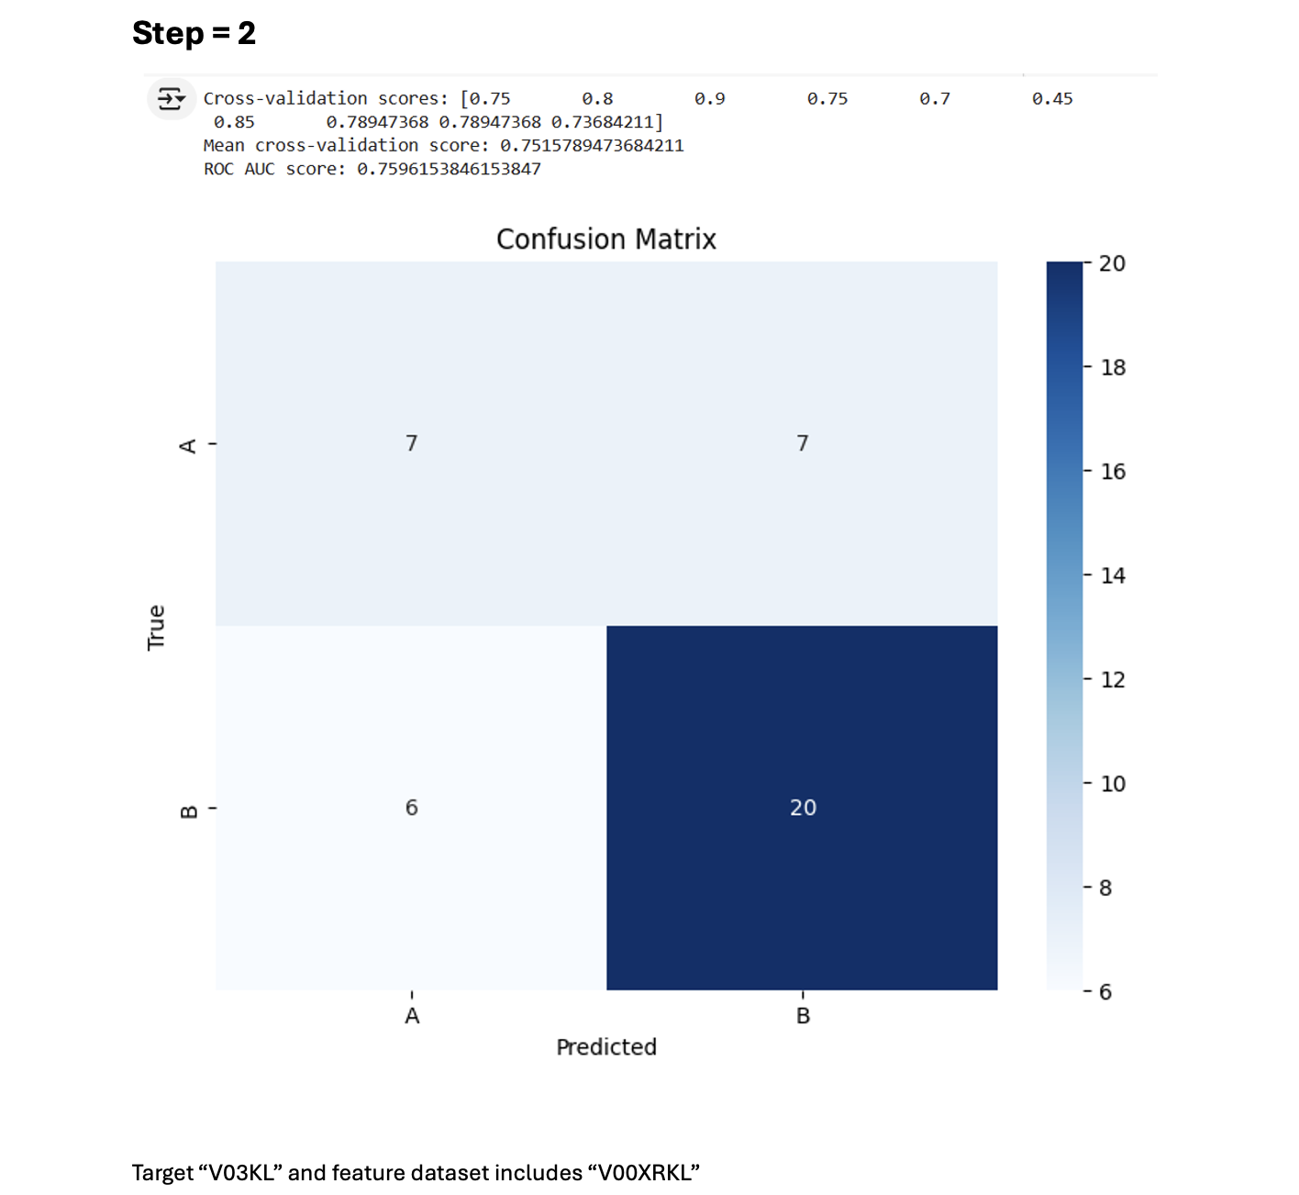
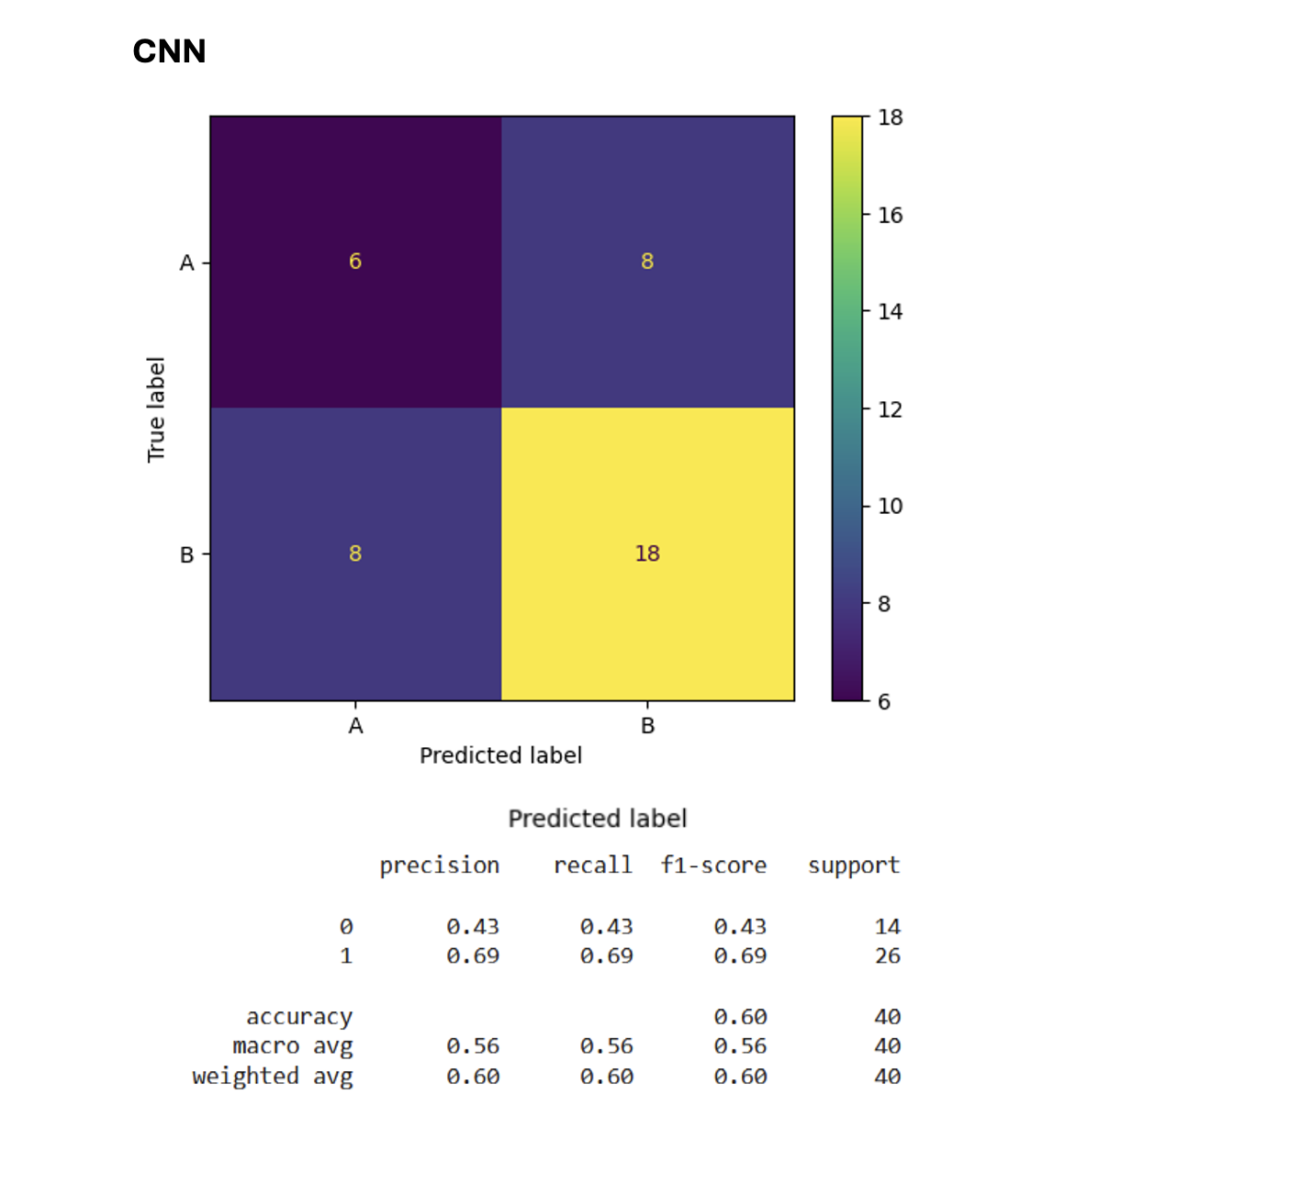

Product benefits
Online store and market swap

Slide 16
Conclusion
Successfully developed a machine learning pipeline to classify knee OA severity using femur-tibia bone distances extracted from MRI-derived bone masks.
Created and optimized 3 feature vectors, applied feature selection, and preprocessed data to improve model performance.
Trained Random Forest and CNN models, testing multiple approaches to achieve reliable accuracies through cross-validation.
The optimized models demonstrated effective OA classification, providing a robust and automated solution for knee osteoarthritis diagnosis.

Slide 17
Thank you

